Slide 1
Gas Turbine

Slide 2
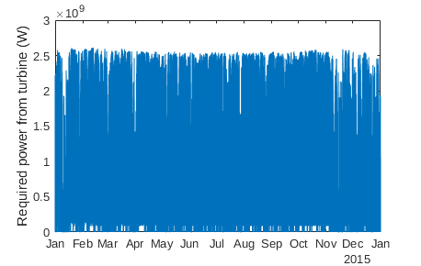
Power Output Requirements
Needs to meet maximum power peaks (~2500 MW)
Low steady-state amount of power at reasonable efficiency when there is enough wind power

Slide 3
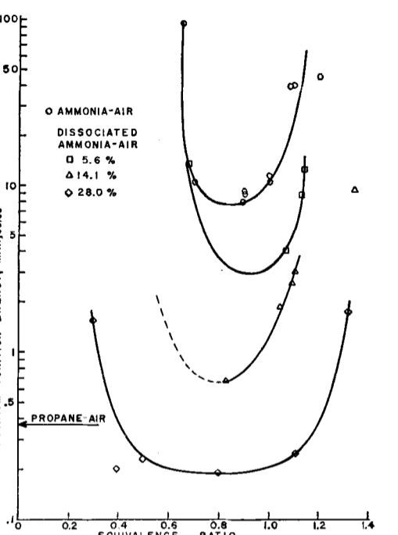
Gas Turbine Design
Axial compressor, axial turbine
Difficulty combusting ammonia, so need heat exchanger and nickel-alumina type catalyst for ammonia dissociation
From research data, temp of 200 degrees C would be sufficient
Ignition Energy (mJ)
Verkamp, Hardin, Williams, ‘Ammonia Combustion Properties
Equivalence Ratio

Slide 4
MATLAB Model
Model calculates power output for given flow rates
MATLAB Model Verification
For identical adiabatic flame temperature, inlet conditions, flow rates, and component efficiencies, MATLAB model was within ~10-20% of ASPEN model
Error within noise of project, may arise from ideal assumptions (e.g. cp, gamma)
 | MATLAB | ASPEN
Compressor outlet temp (K) | 847 | 793

Slide 5
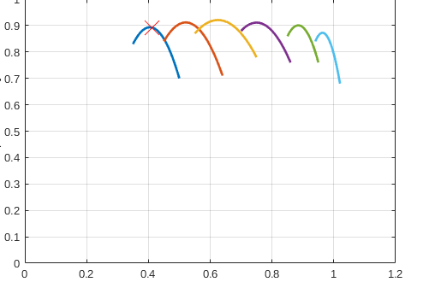
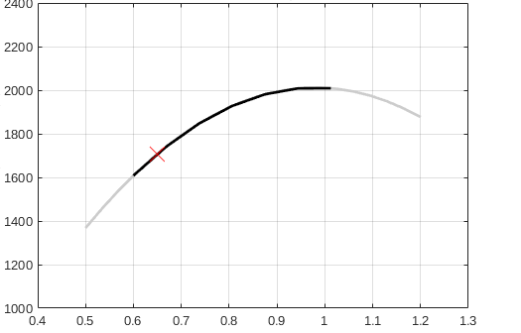
MATLAB Model
Compressor Characteristic
Efficiency
Inc. rotational speed num.
Real combustion does not follow adiabatic flame temperature
Non-ideal compressor and turbine vary with flow rate, inlet conditions, rotational speed
Component characteristics taken from literature, research
Design Value:
Max power ER = 1, P_out ~ 2500 MW for 82kmol/air
Steady state ER = 0.6, P_out ~51 MW for 30kmol/air
Equivalence Ratio
Burner Temperature
Experimental Flame Temp
Equivalence Ratio

